Slide 1


GBC Navigation App
T32
Talha Sultan, Jason Thai
Research project by Professor Jawad Butt
Mentor : Professor Mike Denton

Slide 2
Review Project Description
Current problems navigating in and out of campus
Solution:
An application that helps new students or visitors to guide to and within the Casa Loma campus by selecting parking areas located around the campus.

Slide 3


Project Status Report
Summary
Continue working with Ionic framework
Discontinue FireBase
Implementing interior map of E and D building
(origin and destination points / NEW CHANGES PROVIDED BY STAKEHOLDER)
Fix mistakes and apply new requirements noted by stakeholder (fix incorrect paths and re-modify interior paths)
Attempting to resolve IOS Build errors

Slide 4


Review of Ionic and Discontinuing Firebase
Open-source SDK for hybrid mobile app development
Integrated with Angular
Reasons for discarding Firebase and Ionic Plugins
Ionic Plugins (GPS : outdated / deprecated / other issues, causing device to crash)
Firebase Issues with Cross platform (either Android or IOS fails to make connection)
Not REQUIRED by stakeholder (only for developers debugging, logging purposes)

Slide 5
In Progress and Accomplishments
In Progress
Accomplishments
Redraw exterior routes and paths
Finishing up interior E and D buildings (origin and destination)
Render interior map with origin and destination points, along with selection of specific rooms

Slide 6

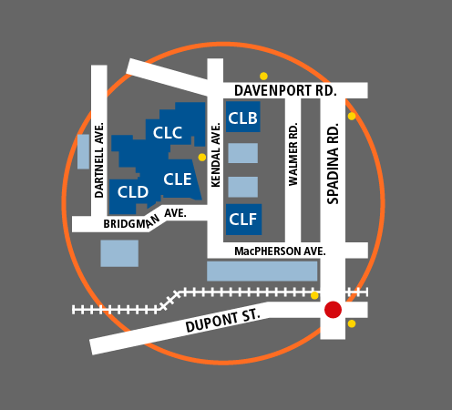
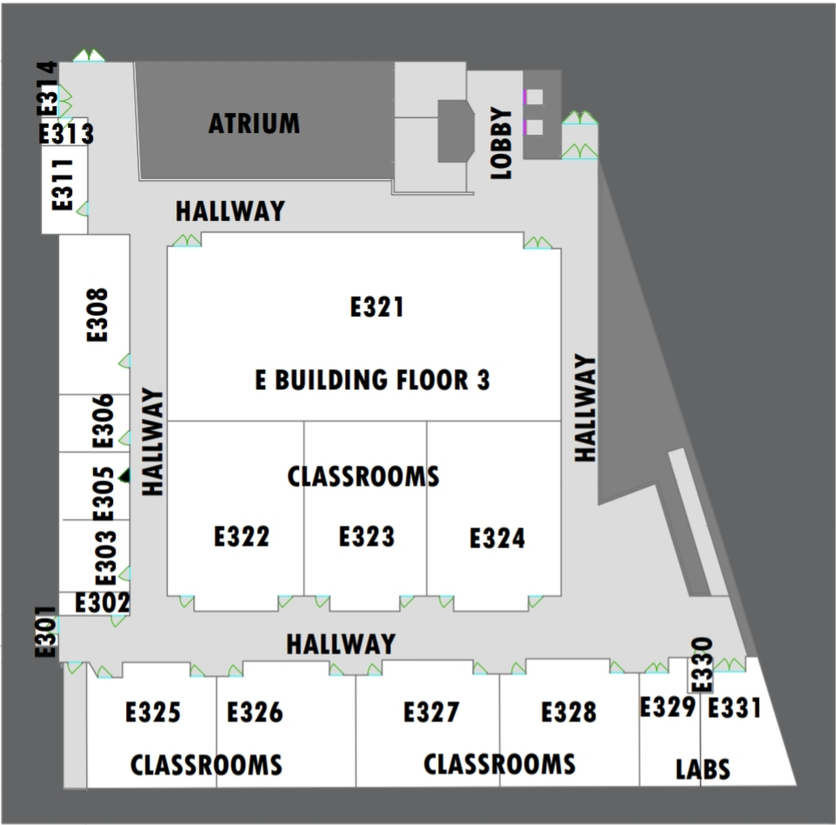

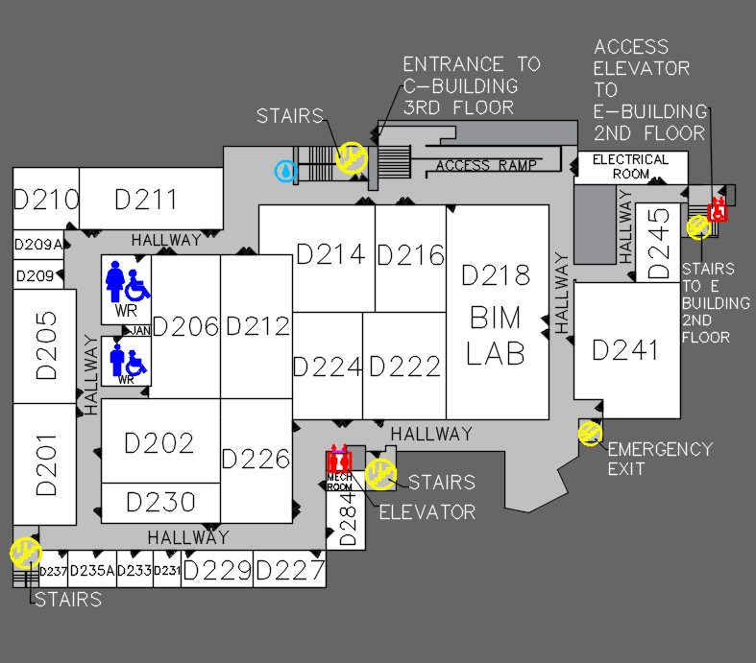
Milestone for the next period
Complete ground floor interiors, including the paths
Notes:
Consider talking about:
Theoretical computer science
Computer systems
Computer applications
Software engineering

Slide 7
Demo

